Slide 1
IBM University Engagement Project Submission
“Exploring the Power of Agentic AI with IBM Granite and LangFlow”

Slide 2

Project Title – AgriLink AI
Domain of Project – Economic Development
Student Name | Recent Passport Photo | Email ID | Mobile number [WhatsApp]
PATEL NAMRA VISHNUBHAI |  | patelnamra1405@gmail.com | 9825352273

Slide 3
Problem Statement - Agricultural Market Access
The Challenge
Farmers often struggle with limited market information, credible buyer access, and informed selling decisions. Without timely price insights and simple AI-powered guidance, they may find it difficult to decide when, where, and at what value to sell their produce.
The Objective
Build an AI-powered AgriLink AI platform that delivers market intelligence, buyer connections, and selling guidance for farmers. The solution should:
Price Intelligence – Provide mandi prices, market trends, and price forecasts.
Buyer Discovery – Connect farmers with suitable and credible buyers.
Selling & Storage Advisory – Support informed decisions on whether to sell or store produce.
Quality Guidance – Help farmers understand quality factors and buyer requirements.
Multi-Agent System :–
Market Intelligence Agent – Provides price and trend insights.
Buyer Matching Agent – Connects farmers with relevant buyers.
Selling Advisory Agent – Supports sell-or-store decisions.
Quality & Income Agent – Provides quality guidance and income visibility.
Farmer Dashboard – Show prices, buyers, recommendations, and income insights in one place.

Slide 4
Proposed Solution - AgriLink AI Platform
The proposed solution is an AI-assisted market intelligence and direct-trade platform designed for cotton and groundnut farmers. AgriLink AI brings together market prices, forecasting, buyer discovery, selling guidance, quality assessment, and conversational AI into a single intelligent platform.
At its core, the solution provides mandi-wise price intelligence by presenting current prices, historical trends, and relevant market insights. AI-powered analysis helps farmers understand market movements and make more informed decisions.
The system consists of six key components:
Price Intelligence provides mandi-wise current prices, historical trends, filtering, and AI-generated market explanations.
Forecasting Agent delivers an indicative 7–14 day price outlook based on market trends, confidence signals, and available market factors.
Buyer Matching connects farmers with relevant buyers by comparing buyer types, offers, requirements, and response or fit signals.
Selling Advisor helps farmers evaluate different options, such as selling immediately, storing produce, or exploring direct-buyer opportunities, based on their individual needs.
Quality + Income provides quality assessment guidance and estimated sale or income breakdowns to support better decision-making.
Granite AI Assistant offers conversational guidance in English, Gujarati, and Hindi, making the platform more accessible and easier for farmers to use.
The solution uses IBM Granite as the AI reasoning layer, while LangFlow supports the orchestration of the agentic workflow. Together, these components create a modular system where different AI capabilities work together to provide actionable market guidance.
Overall, KisanSetu delivers an end-to-end intelligent agricultural market platform that helps farmers access market information, connect with buyers, evaluate selling strategies, and make more confident decisions.

Slide 5
Technology Used
LangFlow Platform – For designing and orchestrating multi-agent AI workflows visually.
IBM Granite Model – For natural language understanding, reasoning, and intelligent decision support.
IBM Cloud / watsonx.ai – For building, deploying, and scaling the AI solution with model deployment and AI governance.
RAG (Retrieval-Augmented Generation) – To retrieve relevant market and agricultural data first, then generate informed AI responses.
Vector Database – For storing embeddings and enabling fast retrieval of relevant market information.

Slide 6
Langflow component Used -
Chat Input – Allows farmers to enter queries related to crop prices, buyers, storage, selling decisions, and market insights.
Context / Retrieval – Retrieves relevant market, crop, and farmer-specific information to provide context for AI responses.
IBM Granite LLM / Agent – Processes the user's query and reasons over the available context to generate actionable market insights and recommendations.
Chat Output – Displays AI-generated responses such as price insights, forecasts, buyer suggestions, and selling recommendations.
Specialized Tools / Modules – Connects the AI assistant to modules such as Price Intelligence, Forecasting, Buyer Matching, Selling Advisor, Quality, and Income.
Conversation Context / Memory – Maintains the user's language, query context, and interaction flow for a more consistent conversational experience.

Slide 7

Role of Agentic AI in the solution
Agentic AI enables AgriLink AI to function as an intelligent agricultural market decision-support system rather than a simple chatbot. Using IBM Granite models, it understands farmer queries and uses relevant market and crop information to provide actionable guidance.
The system supports specialized capabilities such as mandi price intelligence, price forecasting, direct buyer–farmer matching, storage and selling advice, quality grading, and income analysis. Each capability addresses a specific part of the farmer's decision-making process.
Agentic AI brings context awareness by considering factors such as the farmer's crop, location, quantity, quality, and current market conditions. It can then help compare different options, such as selling now, storing produce, or choosing a suitable buyer.
It also supports intelligent reasoning and recommendations, converting available market information into simple and actionable insights for farmers.
Overall, Agentic AI makes AgriLink AI context-aware, goal-driven, and decision-focused, helping cotton and groundnut farmers make more informed market and selling decisions.

Slide 8
Novelty and Uniqueness
The proposed AgriLink AI platform stands out by combining Agentic AI, market intelligence, and decision support into a single solution for cotton and groundnut farmers.
Farmer-First Decision Intelligence – Combines price, timing, buyer, and quality insights to support complete selling decisions.
Direct Trade Discovery – Goes beyond market information by helping farmers identify and compare relevant buyer opportunities.
Scenario-Based Advice – Supports decisions such as sell now, store, or explore direct buyers by considering price, quantity, and practical constraints.
Multilingual Accessibility – Provides a simpler experience through support for English, Gujarati, and Hindi interactions.
Explainable AI Experience – Recommendations include reasons, trade-offs, and verification guidance, rather than acting as opaque suggestions.
End-to-End Income View – Connects market intelligence, quality assessment, and income insights to support the farmer throughout the selling journey.
This makes AgriLink AI a decision-focused agricultural intelligence platform, not just a price information or buyer discovery tool.

Slide 9
GitHub Repository Link
Public GitHub Repository: https://github.com/NamraPatel1405/AgriLink-AI
Repository: AgriLink AI
The repository contains the following project files:
app.json – Configuration and project application details for AgriLink AI.
problemstatement.pdf – Problem statement for the AI-Powered Cotton & Groundnut Market Linkage Platform.
projectpresentation.pptx – Complete presentation of the AgriLink AI solution.
Source Code & Supporting Files – Files related to market intelligence, price forecasting, buyer–farmer matching, selling/storage advisory, quality guidance, dashboard, and other supporting components.

Slide 10
Future Scope
Live Market Data Integration – Integrate live mandi and market data for real-time prices and updated insights.
Voice & Regional Language Support – Enable voice interaction and more regional languages for better farmer accessibility.
Vision-Based Quality Assessment – Use image-based AI to assist with crop quality and grading analysis.
Smart Alerts & Notifications – Notify farmers about price changes, buyer responses, and market updates.
Trust & Verification Layer – Add buyer verification and transaction records for safer direct trade.

Slide 11
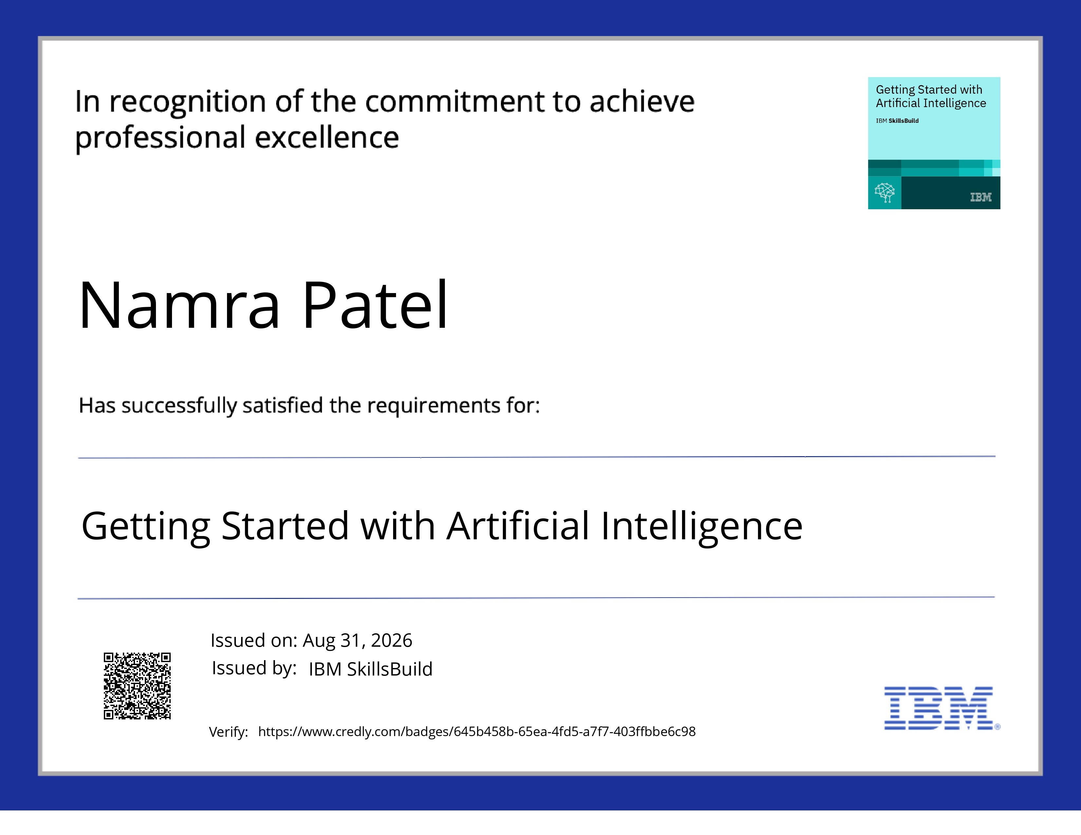
Certificates Earned:​

Slide 12
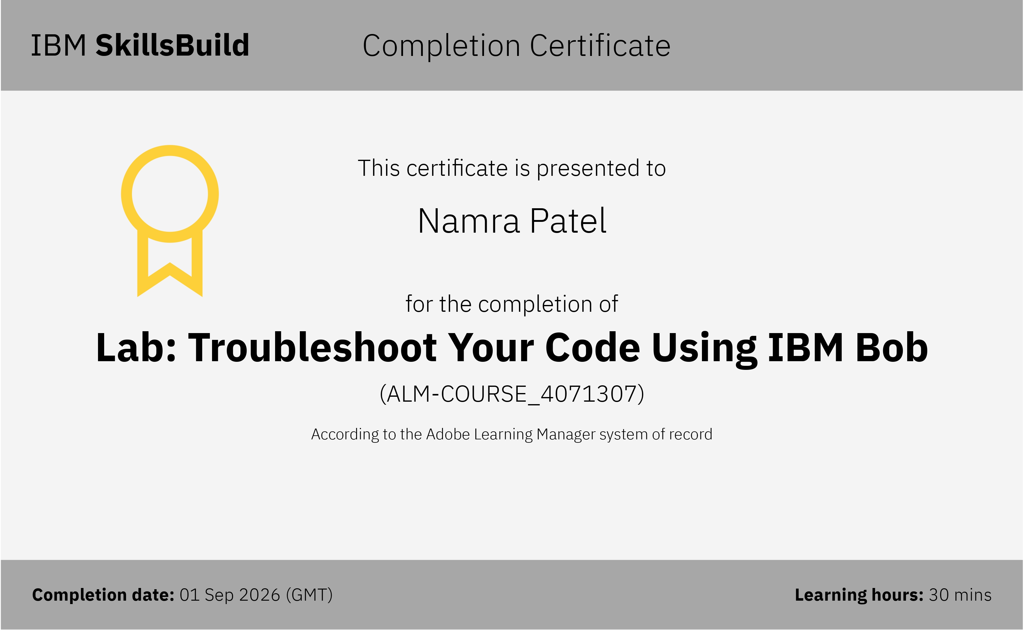
Certificates Earned:​

Slide 13


